Slide 1
Teamworks, Workflow Templates, Notifications and other Actions
This Training Module is Technical in Nature.
It requires working understanding of RDF and TopBraid application development technologies

Slide 2
Section Agenda
Custom Governance Roles
Teamworks and Technical Underpinnings of Working Copies
Workflow Templates
  Deploying to the Server
  Developing in TBC
Notifications
ECA Framework

Slide 3
Custom Governance Roles

Slide 4
Customizing Governance Roles
(for use in Workflow Templates)
Pre-built roles can be configured out (deactivated)
New roles specified
Recommended Practice:
  Create a new ontology in EDG
  Include in it EDG Schema - Governance Assets
  To create a new role:
    Create a new property of type Workflow Property – using OWL/RDF Properties tab
    Navigate to the Stewardship class and add a relationship using the newly created property
  To disable existing role:
    Select the Stewardship class and deactivate relationship shapes for roles you don’t need
  Include the ontology in the Governance Model

Slide 5
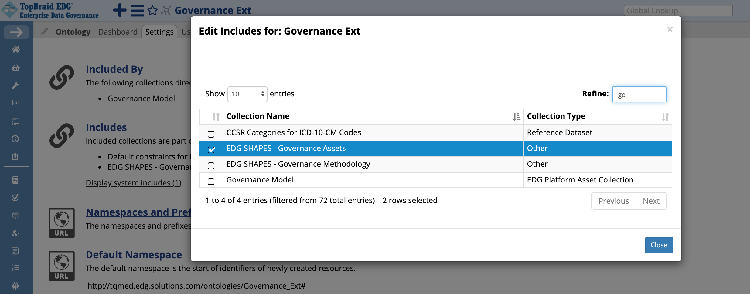
Create a New Ontology to contain customizations to the pre-defined EDG Governance Assets
Go to Settings -> Includes to include EDG Shapes for Governance Assets

Slide 6
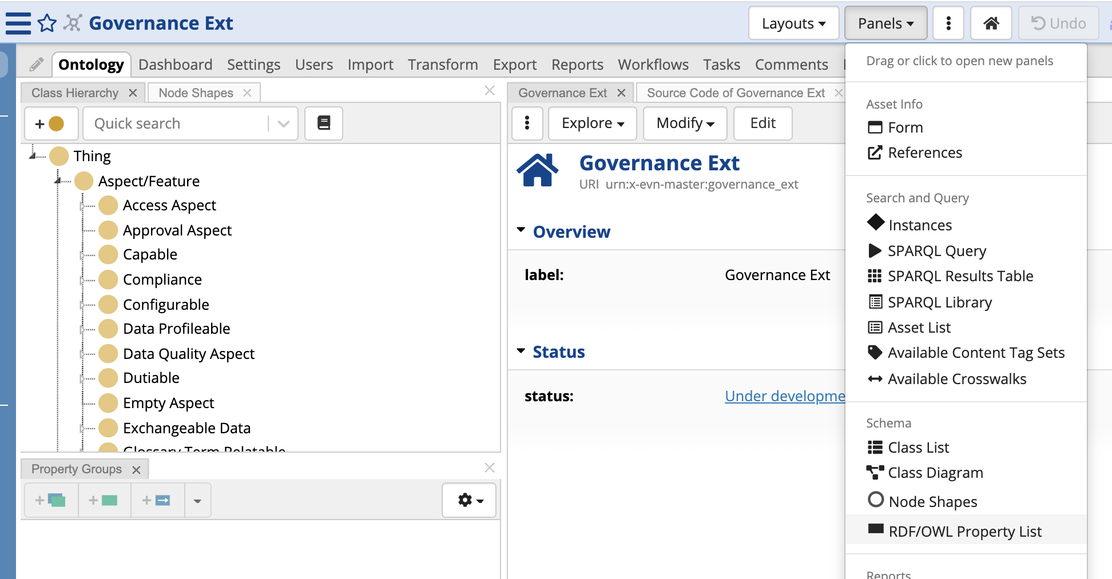
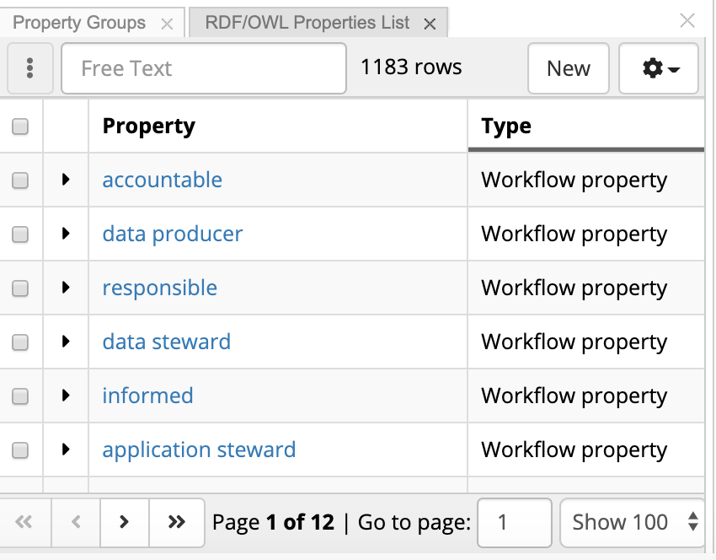
In the Editor, add RDF/OWL Property List panel to see workflow properties
You can sort by Type to see the workflow properties
Drag and drop
Add RDF/OWL Property List panel

Slide 7
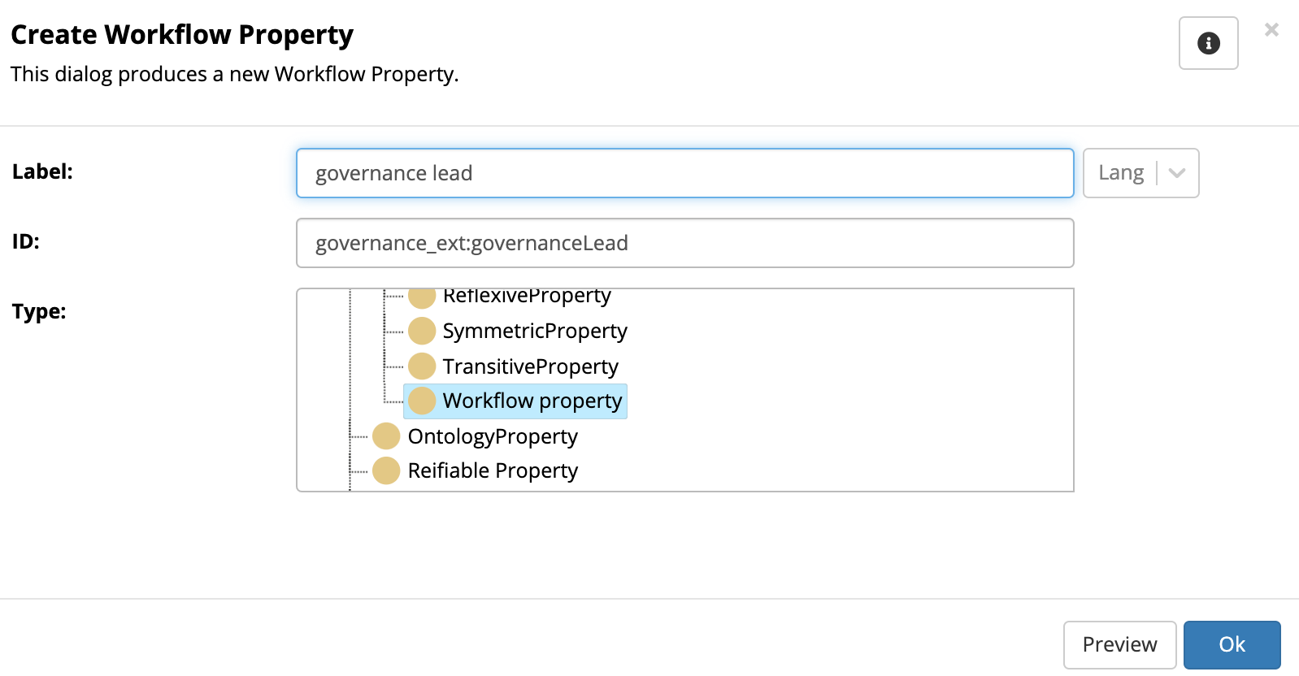
Create a new Workflow property
Type the name of the new role. Use small letters – it will be properly capitalized in the UI
Click New
Select Workflow property as the type (you will find it under Object Property)

Slide 8
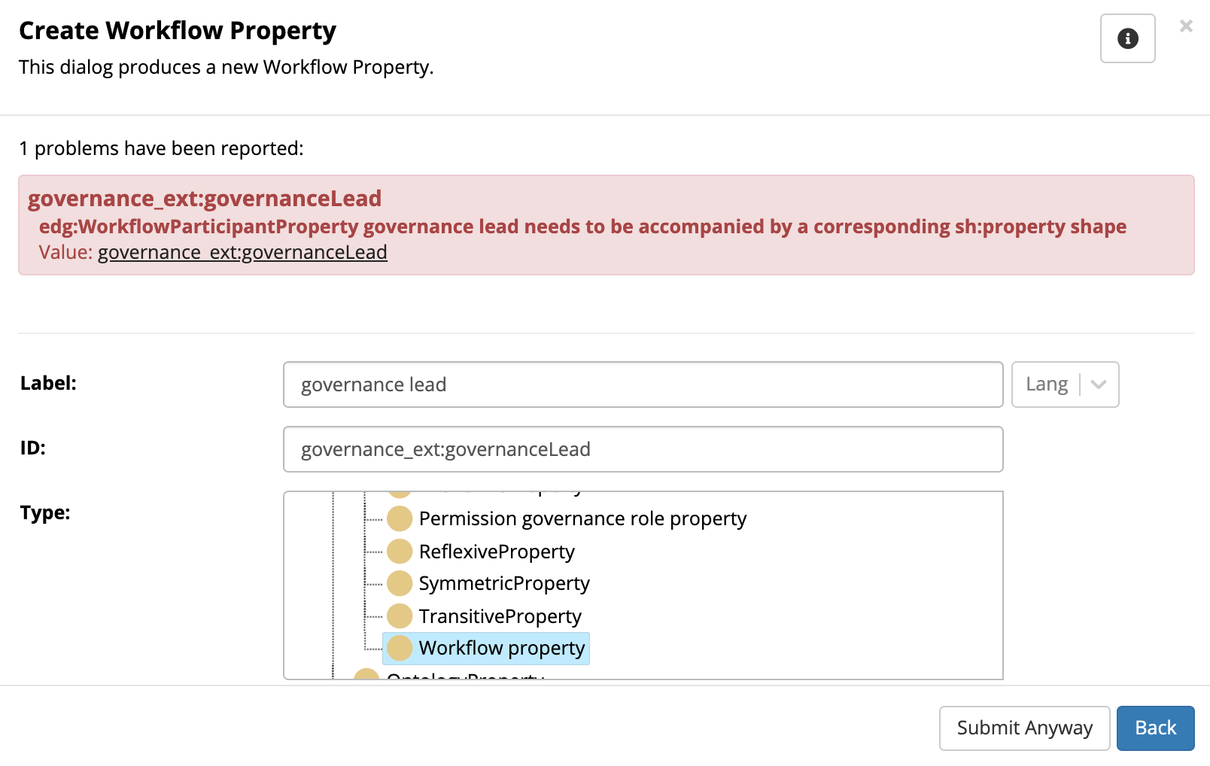
Click “Submit Anyway” when a warning is reported
This is a reminder to create a property shape for the Stewardship - step 2 of the process

Slide 9
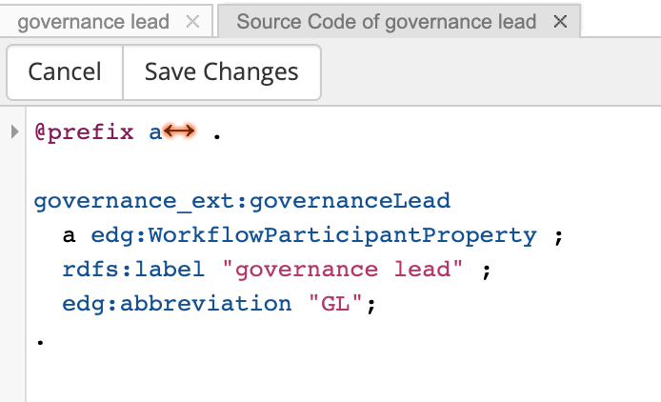
Switch to the Source Code tab to add Abbreviation
Type edg:abbreviation and then the abbreviation in quotes.
For example:
edg:abbreviation "GL";
Make sure this is inserted before the period (“.”) at the end.
Click “Save Changes”
Abbreviation is used in some places in the UI. For example, on the page where notifications are set.

Slide 10
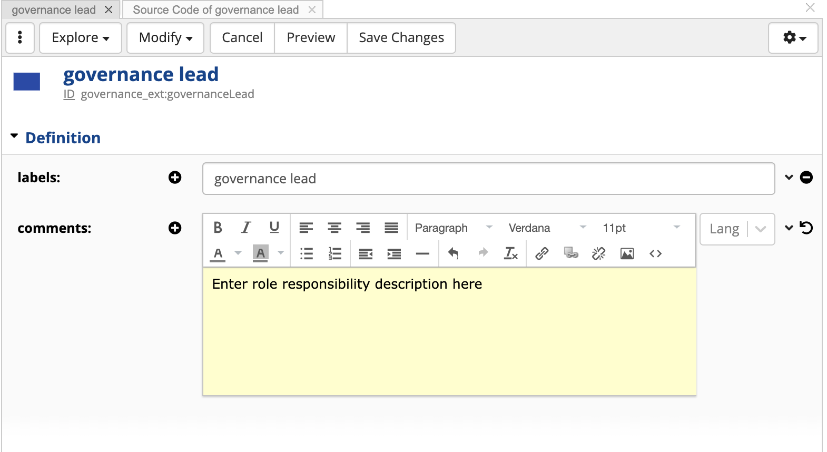
Describe Responsibilities of the Role
In the form, click on Edit and describe role responsibilities in the comments field.
This is optional, but is recommended as a best practice.

Slide 11
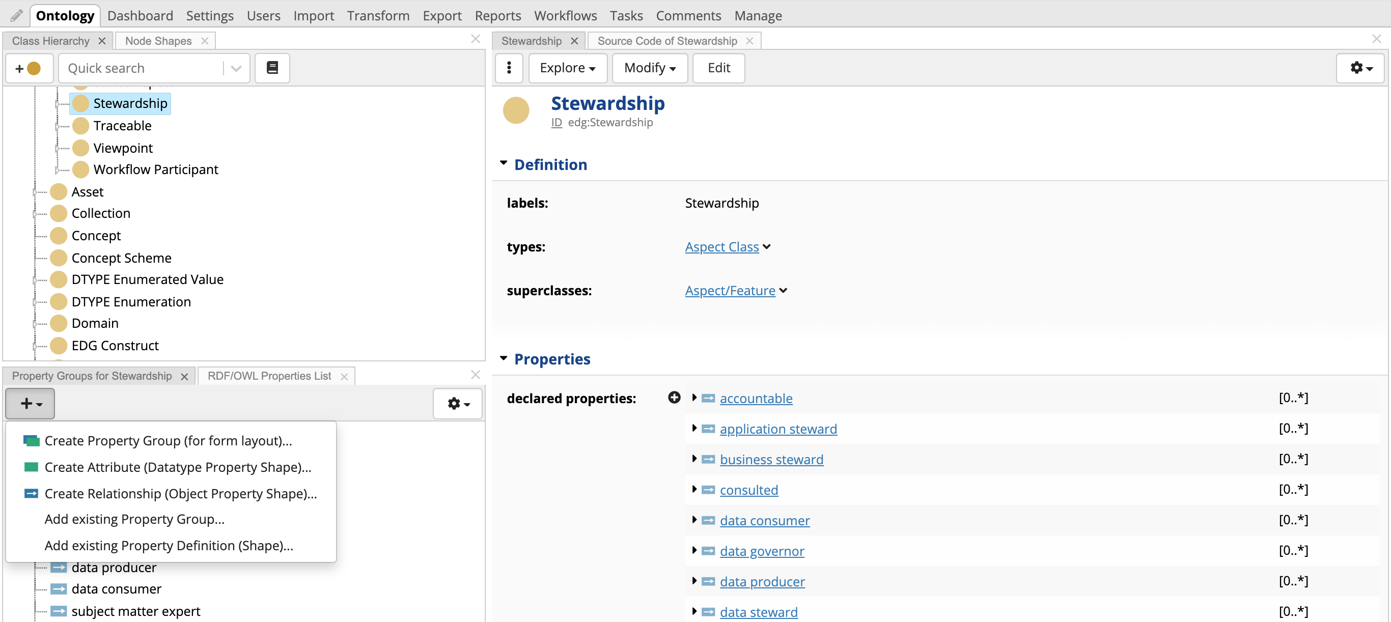
Navigate to the Stewardship class and add a Relationship

Slide 12
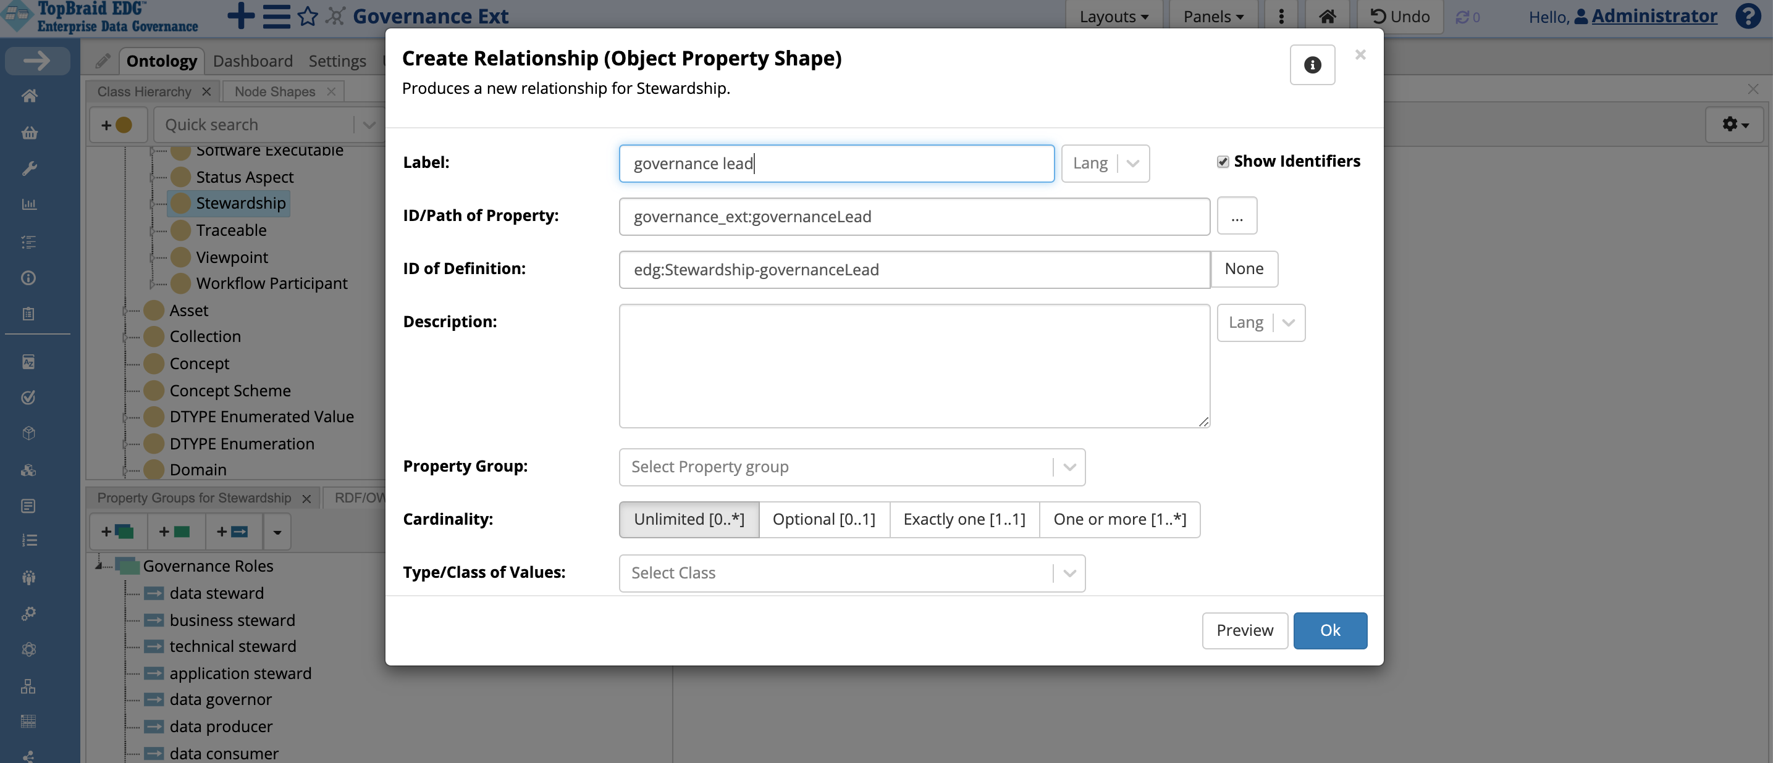
Type the label exactly the same way you typed it when you defined the property
This way, EDG will correctly populate the URI of the workflow property you just created

Slide 13
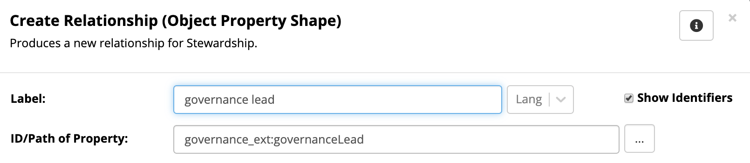
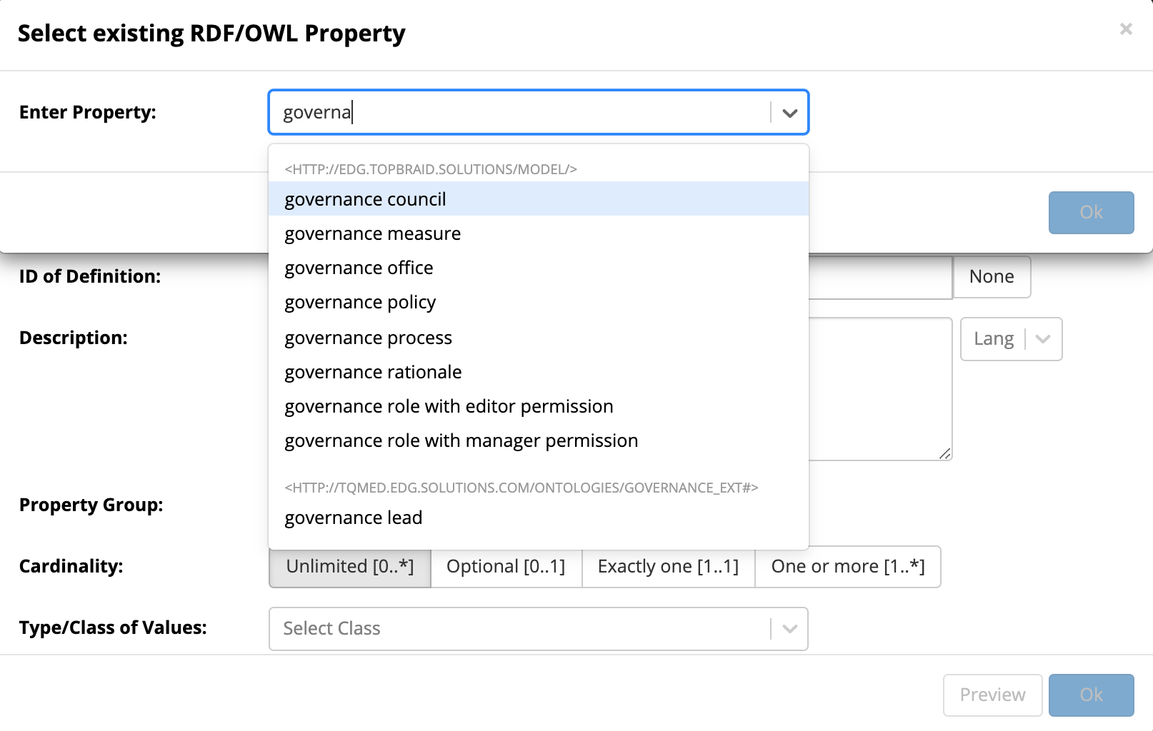
Alternatively, if you are not sure, you can select the property
Select property
Once you select your property, do not change the relationship label.
Changing the label will change the URI of the property and you want to make sure that you are using the workflow property.

Slide 14
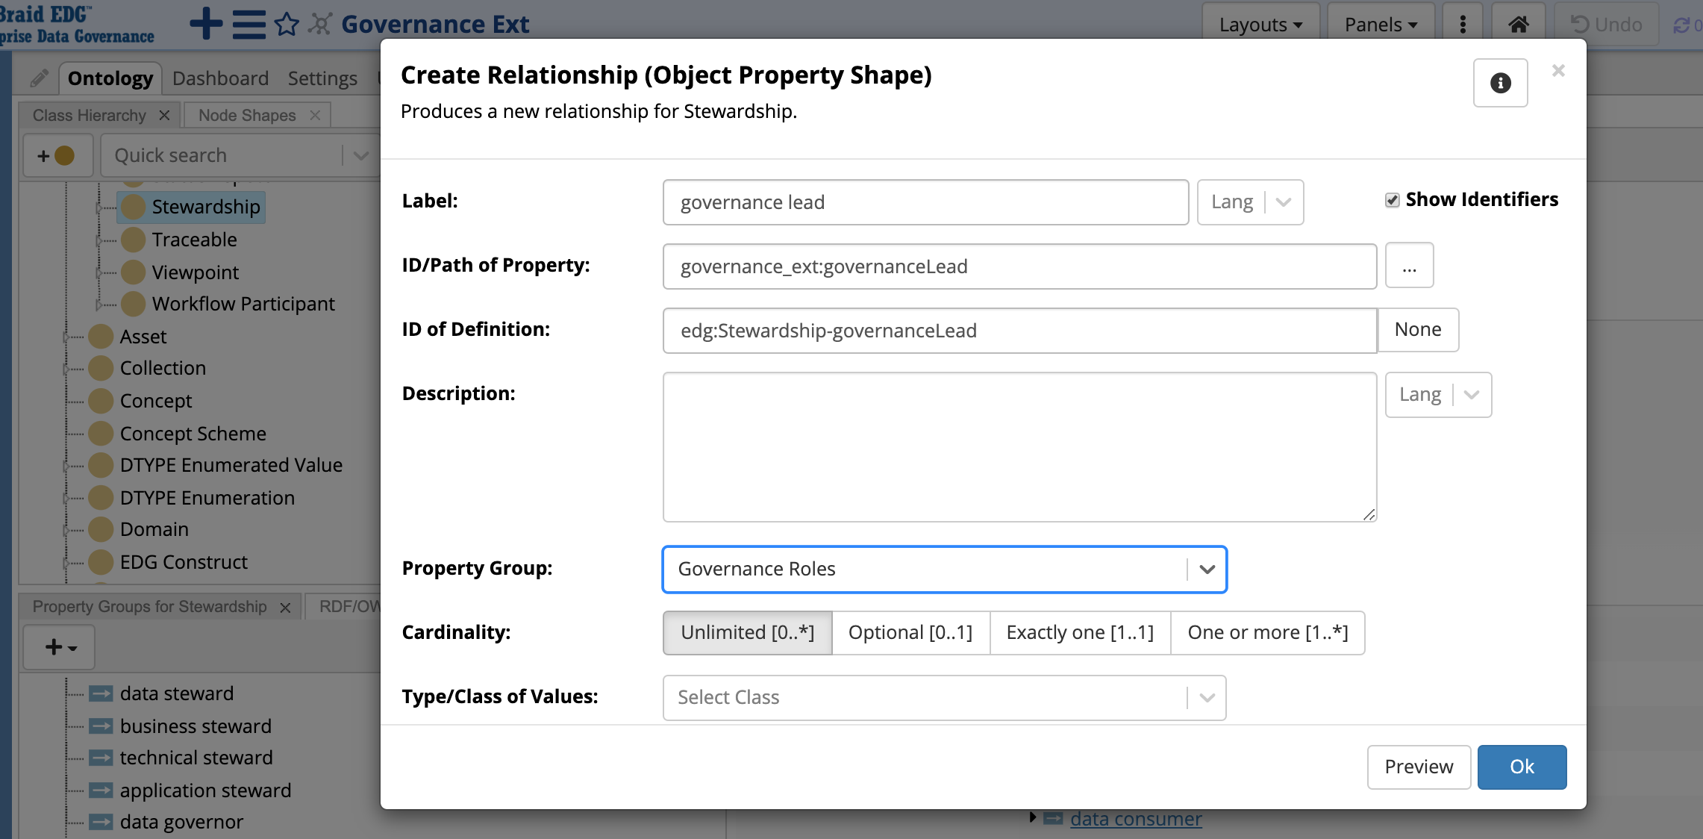
You do not need to set any constraints
Make sure “Governance Roles” group is selected.
You can also add the group later.

Slide 15
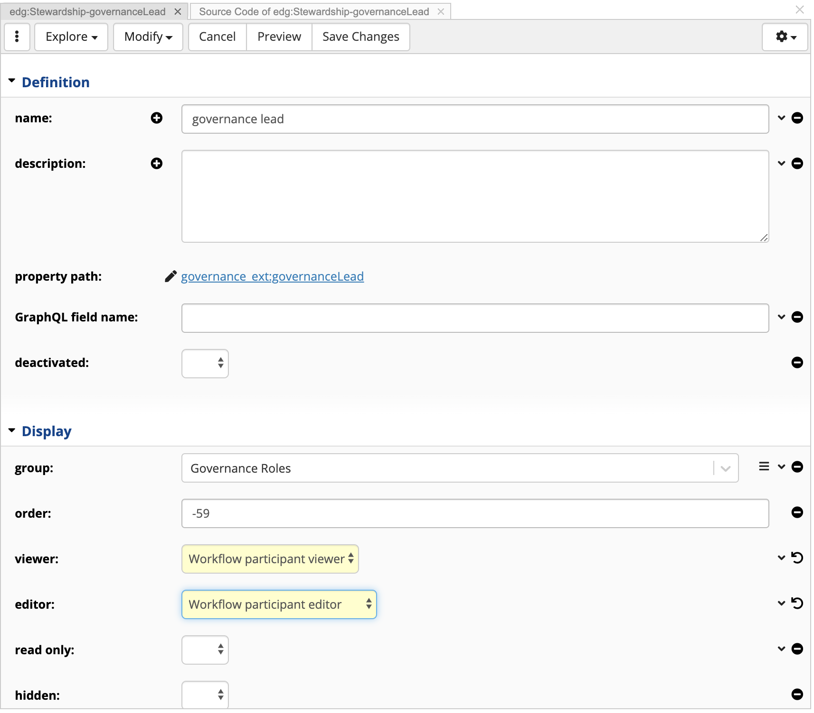
Edit Relationship after it is created - to set view and edit widgets
Select “workflow participant viewer” and “workflow participant editor”.
This is needed to enable assignment of users for the role

Slide 16
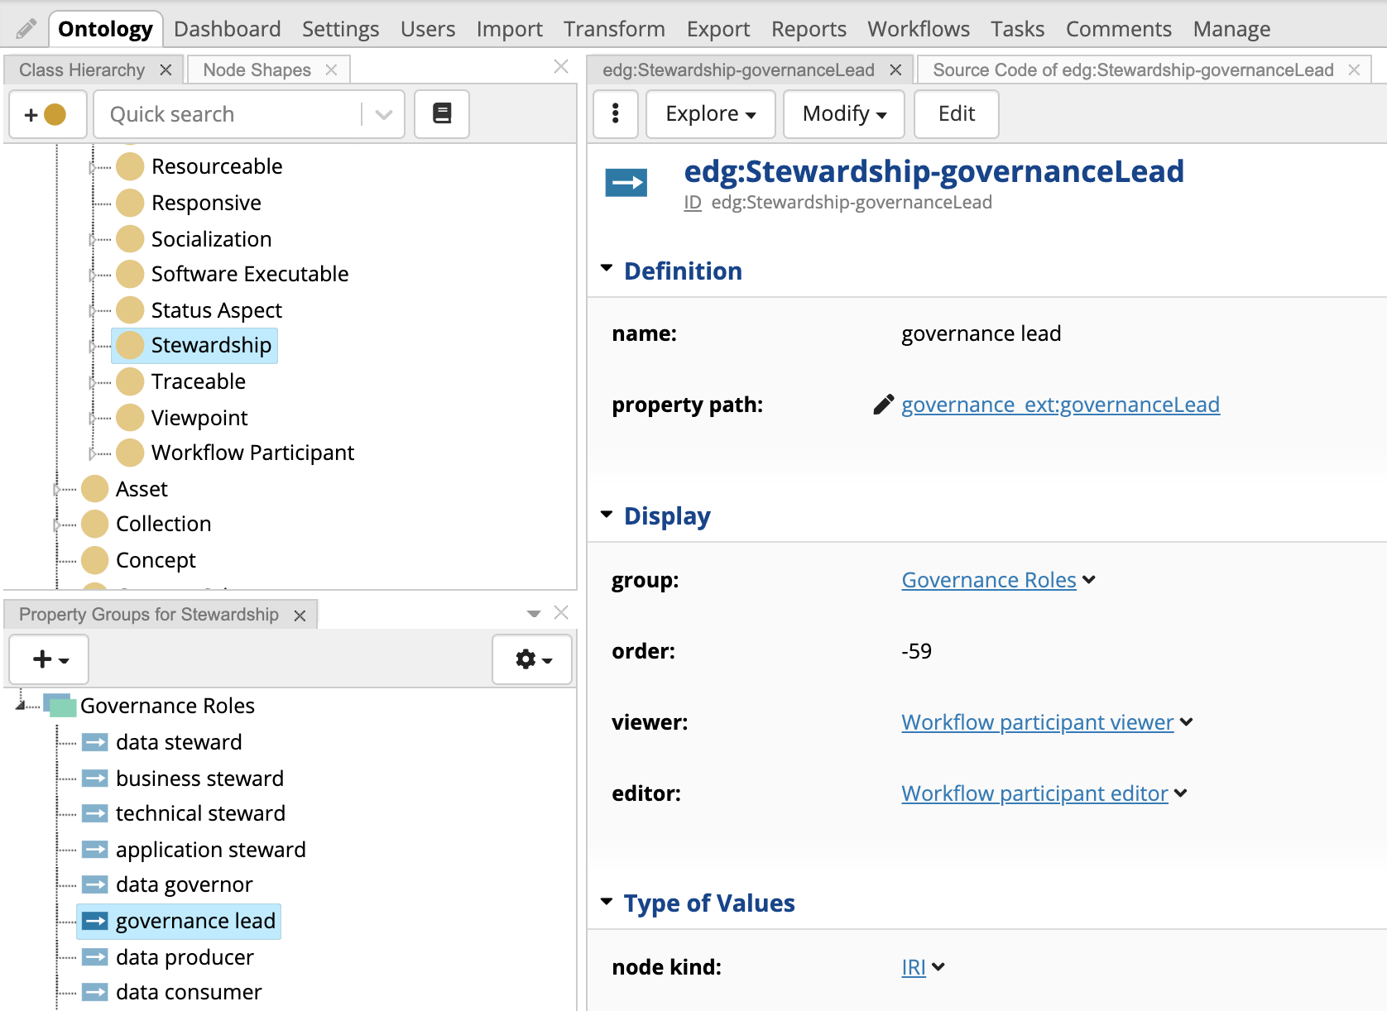
New Stewardship Relationship Defined
Note that your value for the “order” will be different from shown here.
You may drag and drop the relationship in the Property Groups panel to change the order, or edit it on the form or even leave it blank.

Slide 17
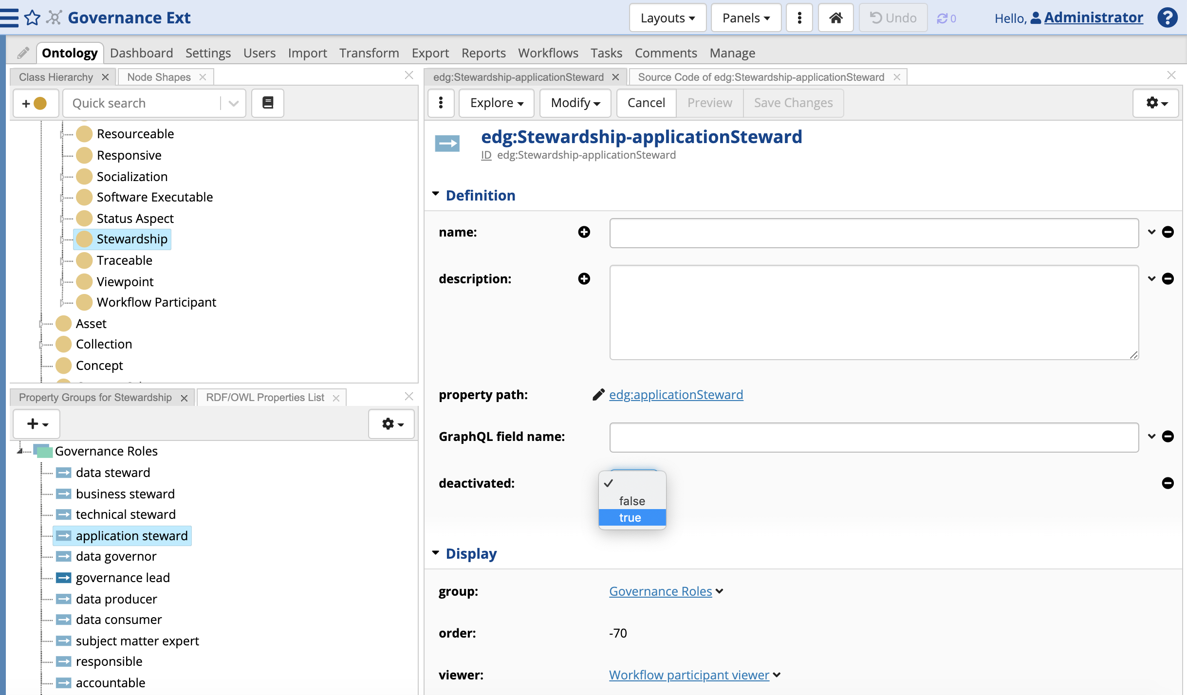
To remove any of the Roles, deactivate the Relationships
Click on a role you don’t want to use
Edit to set ‘deactivated’ to ‘true’.

Slide 18
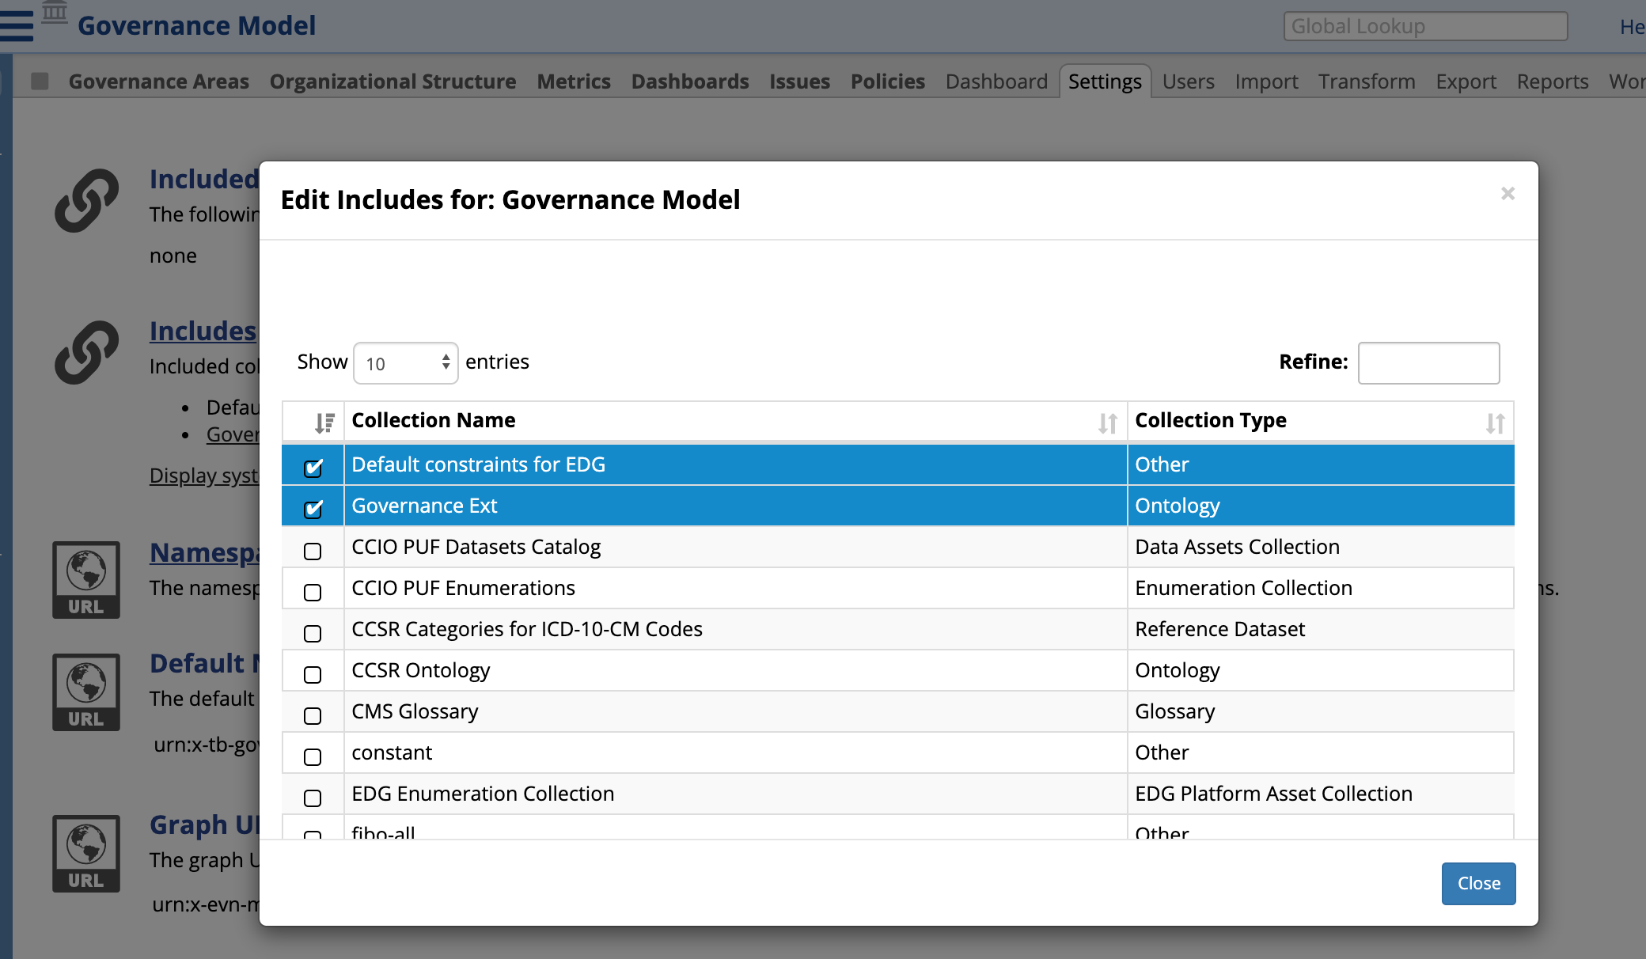
Include your new Ontology in the Governance Operational Model
Click on a page under Governance Model in the navigator e.g., Governance Areas.
Select Settings -> Includes to include your new ontology.
Important: All EDG users must be given read access to the new ontology prior to its inclusion in the Governance asset collection.

Slide 19
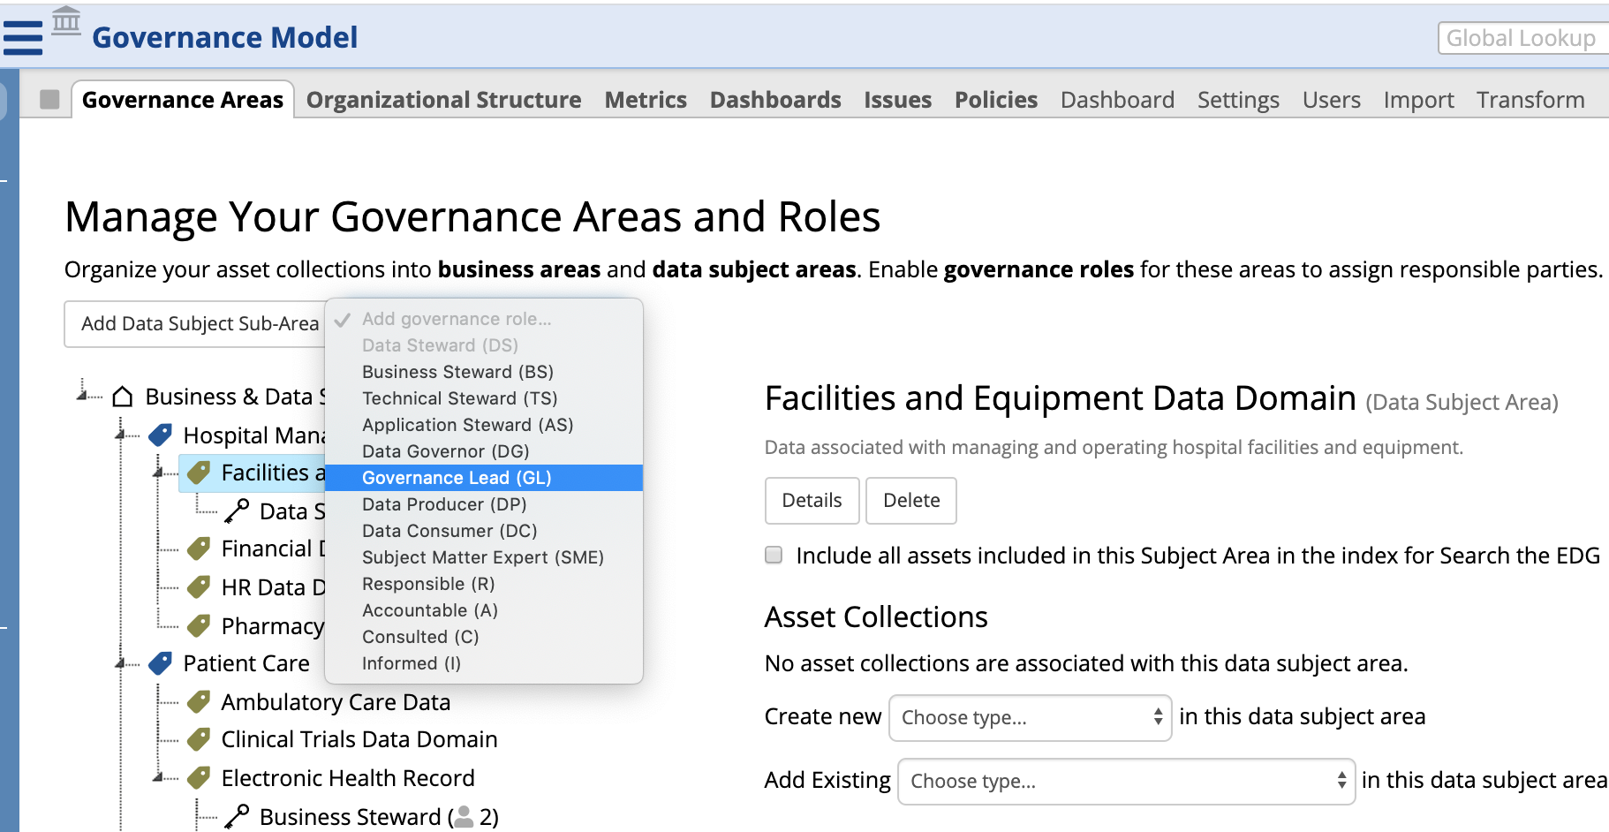
Now, your changes are part of the Governance Model
You will see your new role.
If you deactivated any roles, you will no longer see them.

Slide 20
Technical Underpinnings of Working Copies

Slide 21
What is Teamwork Graph?
Each asset collection has .tch graph that holds audit trail of changes made to the collection
Each change has information about the user that made the change and when it was made and a pointer to triples that were changed
Changes made within a specific workflow have a pointer to that workflow (teamwork:tag)
The .tch graph resource itself contains information about when an asset collection was created and when it was last updated

Slide 22
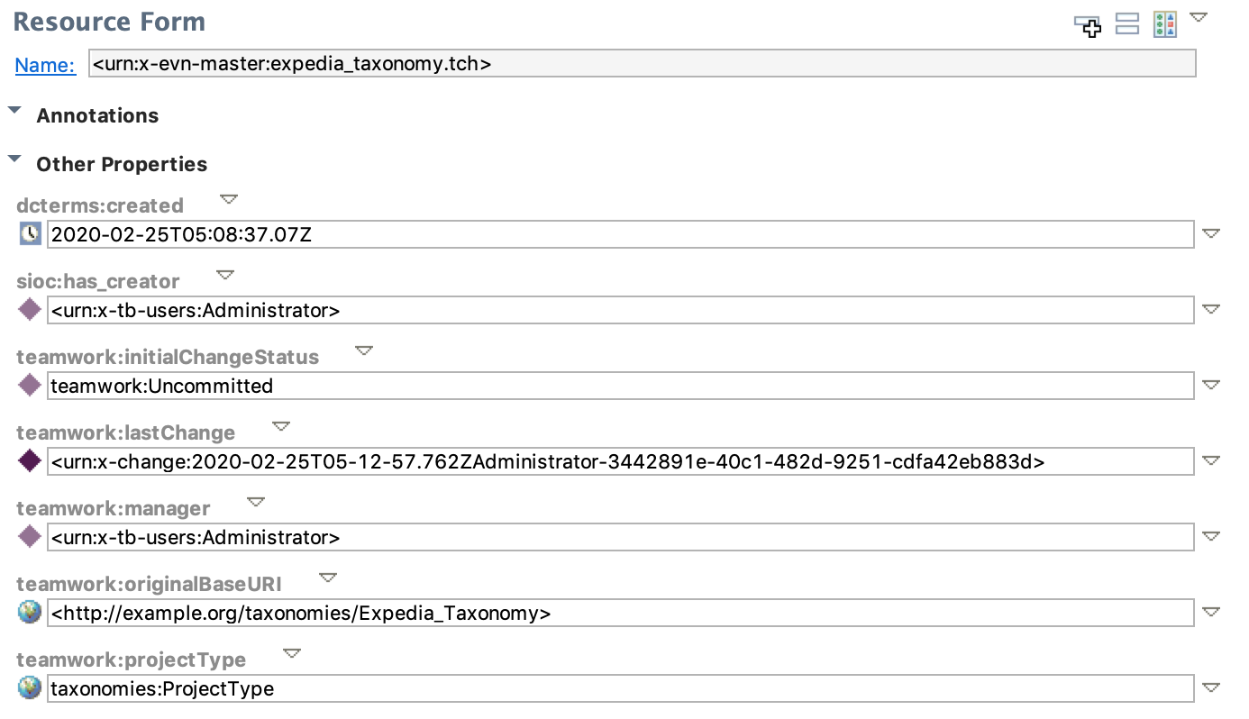
Example .tch Graph Resource

Slide 23
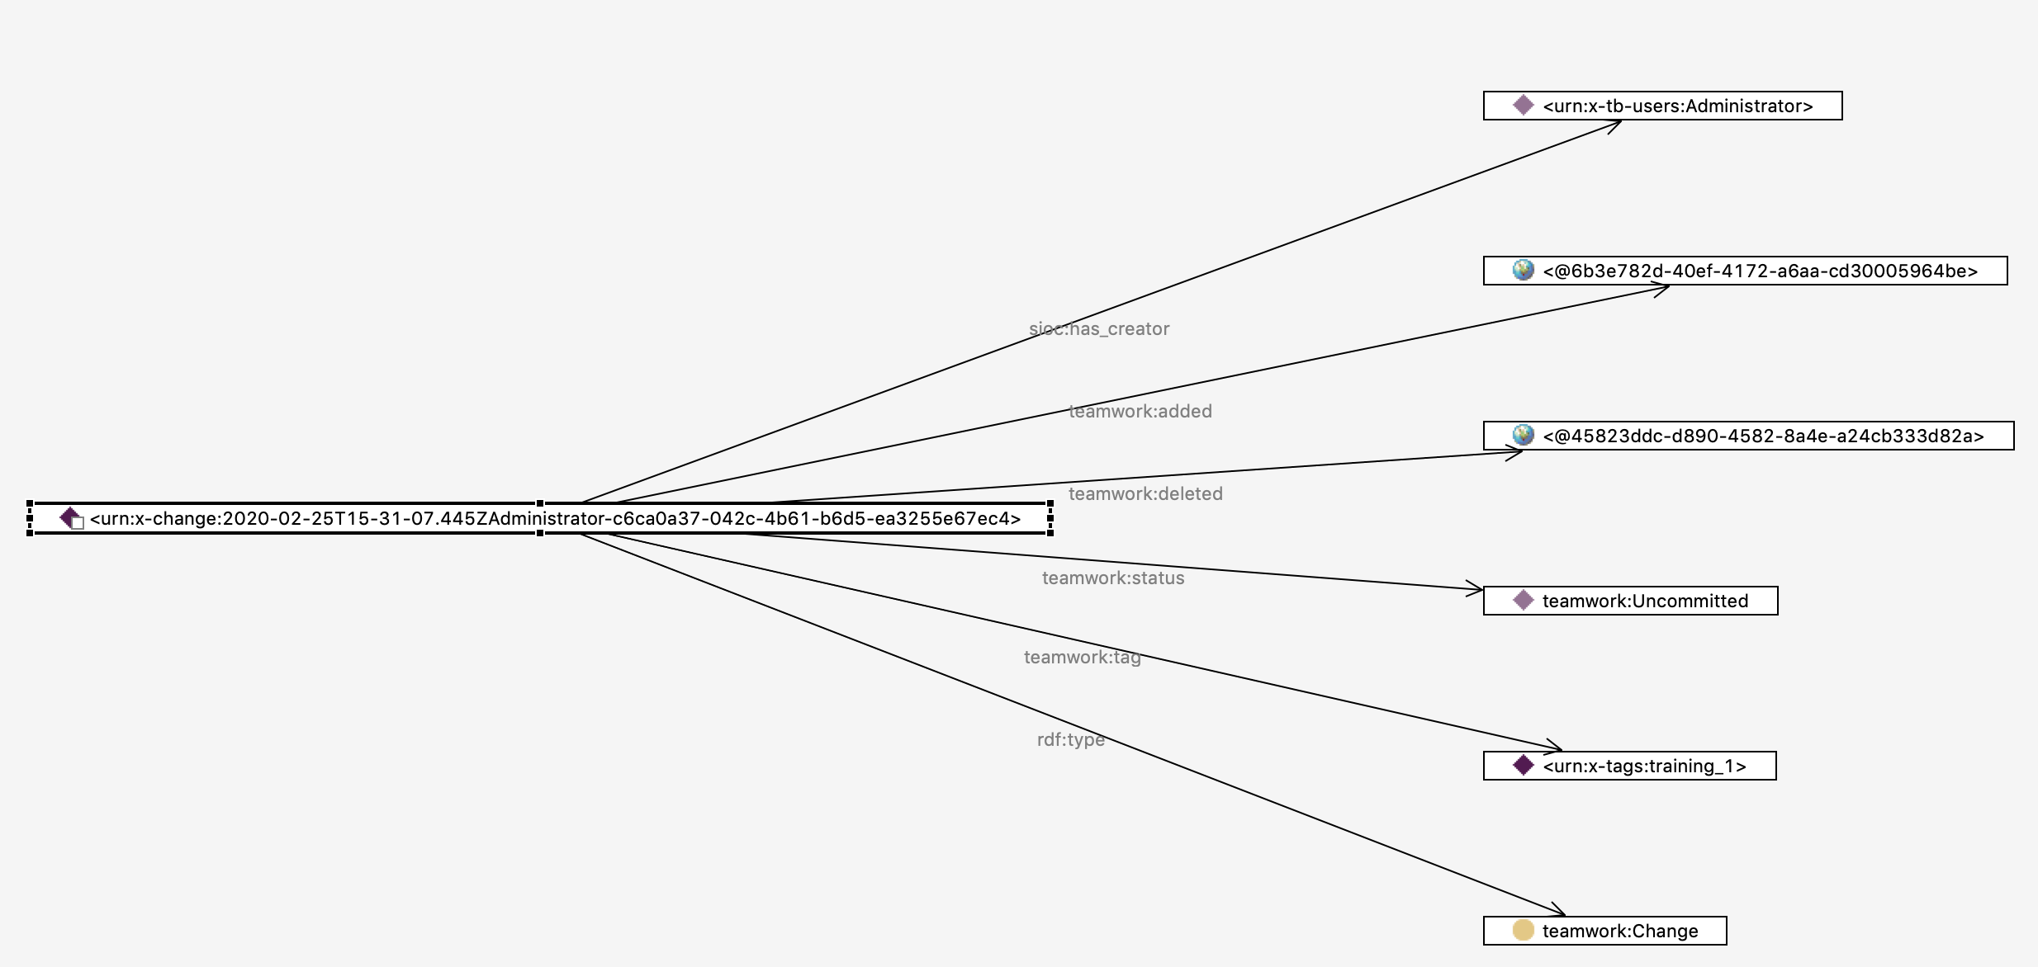
Example Change

Slide 24
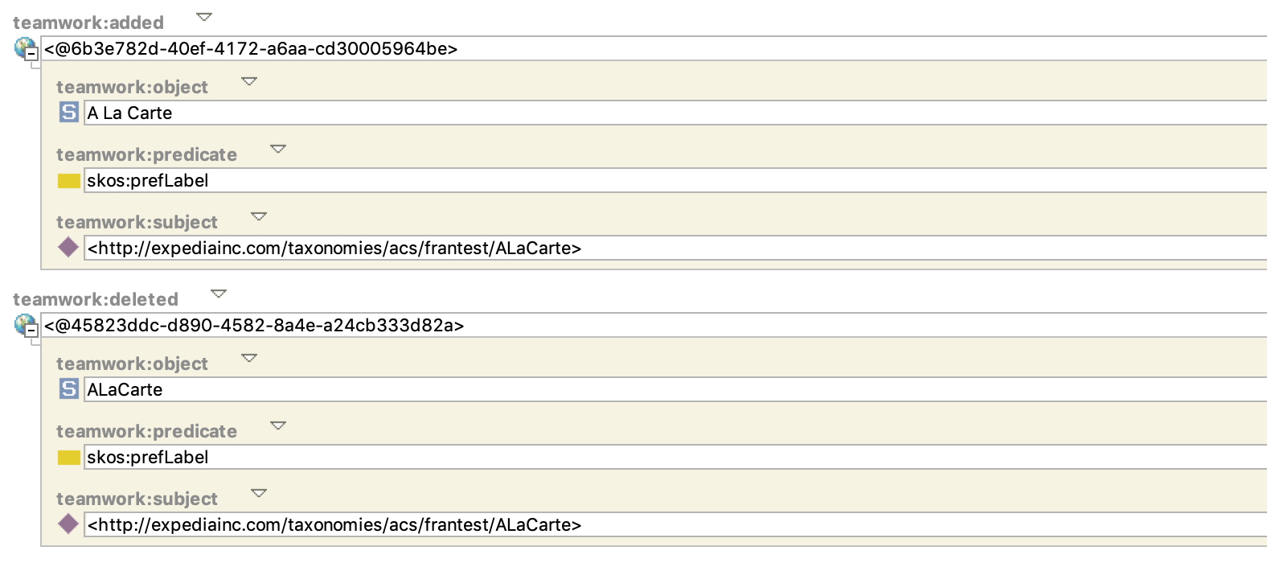
Added and Deleted Triple

Slide 25
What are Working Copies?
Working copies are a view of the asset collection data with changes made in a particular workflow applied
Working copies are virtual – a little similar to a view in a relational database because they are “computed”
The computation takes a production copy of a collection and applies to it a set of changes (additions and deletions) tagged in an audit trail with a given workflow
Result is presented to a user as if she was working with an actually existing version of an asset collection
Can be queried as any other graph

Slide 26
How does a Workflow look like in the Audit Trail?
It is a resource of type teamwork:Tag
<urn:x-tags:training_1> rdf:type teamwork:Tag ;
dcterms:created "2020-02-25T10:30:40.228-05:00"^^xsd:dateTime ;
sioc:has_creator <urn:x-tb-users:Administrator> ;
rdfs:label "Training 1" ;
teamwork:editedResource <http://example.com/taxonomies/ALaCarte> ;
teamwork:lastChange <urn:x-change:2020-02-25T15-31-07.445ZAdministrator-c6ca0a37-042c-4b61-b6d5-ea3255e67ec4> ;
teamwork:manager <urn:x-tb-users:Administrator> ;
teamwork:status teamwork:Uncommitted ;
teamwork:statusChange [
dcterms:created "2020-02-25T10:31:26.779-05:00"^^xsd:dateTime ;
sioc:has_creator <urn:x-tb-users:Administrator> ;
teamwork:newStatus teamwork:FrozenForReview ;] ;
teamwork:statusChange [
dcterms:created "2020-02-25T12:11:15.574-05:00"^^xsd:dateTime ;
sioc:has_creator <urn:x-tb-users:Administrator> ;
teamwork:newStatus teamwork:Uncommitted ;] ;
teamwork:workflowTemplate teamwork:DefaultTagWorkflowTemplate.
Its current state is Uncommitted
It went through two status changes (transitions): to Frozen For Review and then to Uncommitted
It is based on the default template

Slide 27
What changes does it contain i.e., what is used to create its working copy?
Look for instances of teamwork:Change that are connected to the workflow

Slide 28
What you can do with a Working Copy?
Export it
  This will export the computed view of production copy plus changes
Import data into it
  This will write changes into the .tch graph
Query it with SPARQL
  It has a URI e.g., urn:x-tags:training_1
  Go to Settings tab to see the URI
  Query it with GraphQL
  Access it using TopBraid Services

Slide 29
What you can’t do with a Working Copy?
Working copies can not include other working copies
Prior to 6.4 you could not modify includes of a working copy through EDG UI
  Could be done through its SPARQL or GraphQL Endpoint only
  Settings tab was disabled for a working copy. This has changed in 6.4 and you can now have access to the Settings tab to make changes.

Slide 30
Audit Trail Size and Working Copies
A working copy requires a detailed audit trail – it only exists as an audit trail in the teamworks (.tch) graph
Audit trail of the production copy modifications can be minimized – recording only the fact that change happened, not its details (Manage tab)
An asset collection can be configured (Manage tab) to always archive working copy’s audit trail on Commit

Slide 31
Workflow Templates

Slide 32
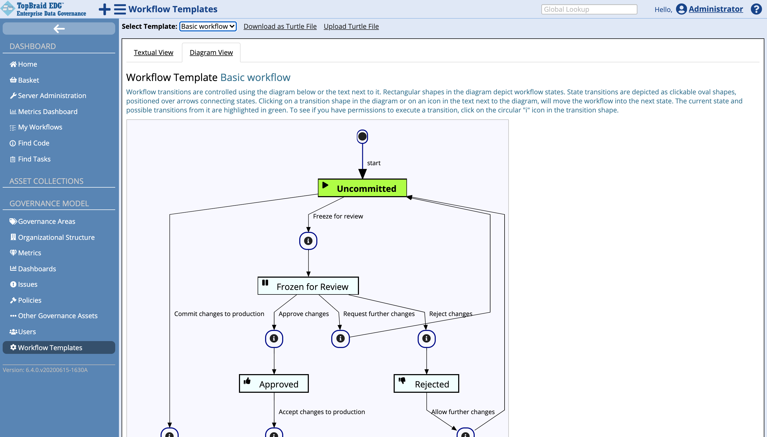
Installed Templates can be Downloaded

Slide 33
Initial File has no Data except for a reference to the “basic workflow”
@prefix teamwork: <http://topbraid.org/teamwork#> .
@prefix sh: <http://www.w3.org/ns/shacl#> .
@prefix owl: <http://www.w3.org/2002/07/owl#> .
@prefix rdf: <http://www.w3.org/1999/02/22-rdf-syntax-ns#> .
@prefix xsd: <http://www.w3.org/2001/XMLSchema#> .
@prefix edg: <http://edg.topbraid.solutions/model/> .
@prefix rdfs: <http://www.w3.org/2000/01/rdf-schema#> .
@prefix dash: <http://datashapes.org/dash#> .
<urn:x-evn-workflows> a owl:Ontology ;
  rdfs:label "Workflow Templates Graph" ; <http://topbraid.org/swa#defaultNamespace> "urn:x-evn-workflows:" ; owl:imports <urn:x-evn-master:platform_governance_singleton> , <http://topbraid.org/teamwork> .
This is where the basic workflow is defined

Slide 34
Template Update Process
Currently the workflow templates file is edited using TBC
  To simplify the use of the roles, collection types, etc., you can temporarily include the Governance schema in it
  Remove the include before uploading
Uploaded to the server via ‘Upload Turtle File’ button
Upload overrides whatever was previously installed
Must be an Administrator to perform this operation
Basic template is not part of the downloaded file, so it can not be removed through this process
To disable Basic template, set its scope to owl:Nothing (or any other resource that will never be used)
While templates are accessed from the Governance section, they are not stored in the Governance Model asset collection
  but in their own dedicated graph - <urn:x-evn-workflows>

Slide 35
Example of a template definition
teamwork:DefaultTagWorkflowTemplate
rdf:type teamwork:TagWorkflowTemplate ;
teamwork:diagramViewClass teamwork:DefaultTagWorkflowDiagram ;
teamwork:initialStatus teamwork:Uncommitted ;
teamwork:transition [
rdf:type teamwork:TagStatusTransition ;
teamwork:fromStatus teamwork:Approved ;
teamwork:toStatus teamwork:Committed ;
teamwork:requiredProjectPermissionRole teamwork:editor ;
teamwork:transitionLabel "Accept changes to production" ;
ui:height 100 ;
ui:width 250 ;
ui:x 670 ;
ui:y 290 ;
sh:order "0"^^xsd:decimal ;
] ;
More transitions …
One of the transitions - from Approved to Committed State
ui: values are used for the diagram display – no longer needed as of 6.3
Notes:
Workflow is a SHACL shape, transitions are also shapes

Slide 36
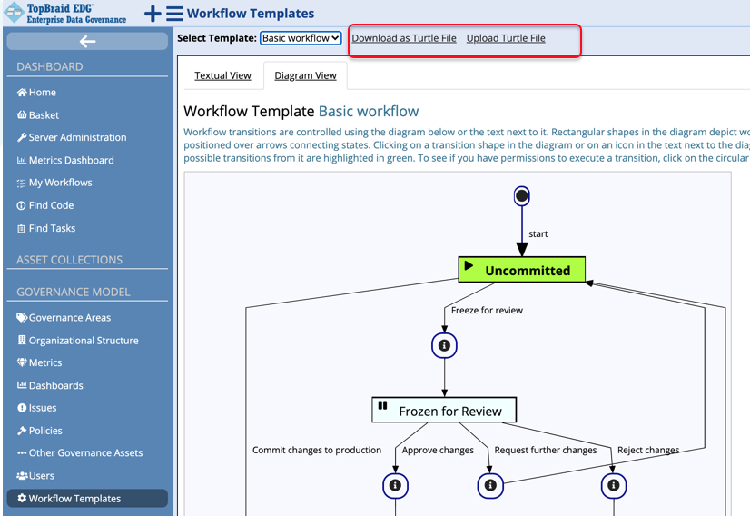
Adding New Workflow Templates
Download the workflow templates file
Edit in TopBraid Composer (TBC) to add new templates
Test locally in TBC-ME
Upload file to the server using the same page you used to download
Important: ALL custom templates are in the downloaded file. If you delete one of them and upload the file to the server, it is a complete replace. You will be deleting templates on the server, replacing them with the file content!

Slide 37
Decisions to make before creating a new template
What asset collections should the workflow be used for?
How many states your workflow will go through?
What users should be able to move the workflow from one state to another state?
Should any transitions happen automatically? Based on what criteria or action?
Do you want to execute some actions as part of any transitions?
Are there special instructions of information that you may want to associate with some of the states?

Slide 38
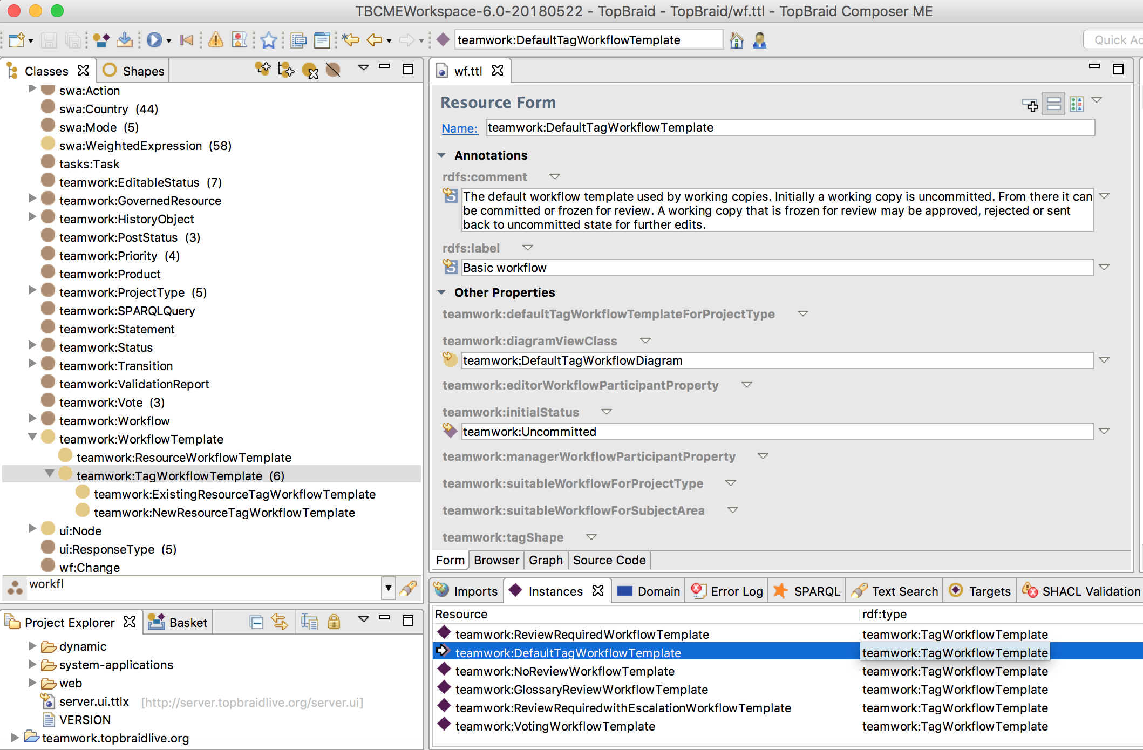
Working with the Workflow Template File in TBC
Select the teamwork:TagWorkflowTemplate class
Instances of this class are the workflow templates
By default, after the installation, you will see a single default template – circled in red in the screenshot: teamwork:DefaultTagWorkflowTemplate
Select it and examine to understand how transitions are defined
Other example templates are available from https://www.topquadrant.com/topbraid-composer-install/

Slide 39
Important Values for a Workflow Template
teamwork:transition – points to each state transition a workflow can go through.
  E.g., from “In review” to “Approved”
  Transitions are SHACL shapes and instances of teamwork:TagStatusTransition
teamwork:initialStatus – defines the initial state of the workflow
Required
teamwork:managerWorkflowParticipantProperty - governance role(s) that will have the manager permission for the workflow. A user that starts a workflow always has manager permission profile. Also a governance role that is specified in the Governance Area page to have the manager permission profile, will have it for the workflows.
teamwork:editorWorkflowParticipantProperty - governance role(s) that will have the editor permission for the workflow. Also a governance role that is specified in the Governance Area page to have the editor permission profile, will have it for the workflows.
teamwork:suitableWorkflowForProjectType – the types of asset collections a workflow can be used with. If not set, then all.
teamwork:suitableWorkflowForSubjectArea – governance areas a workflow can be used with. If not set, then all.
Optional

Slide 40
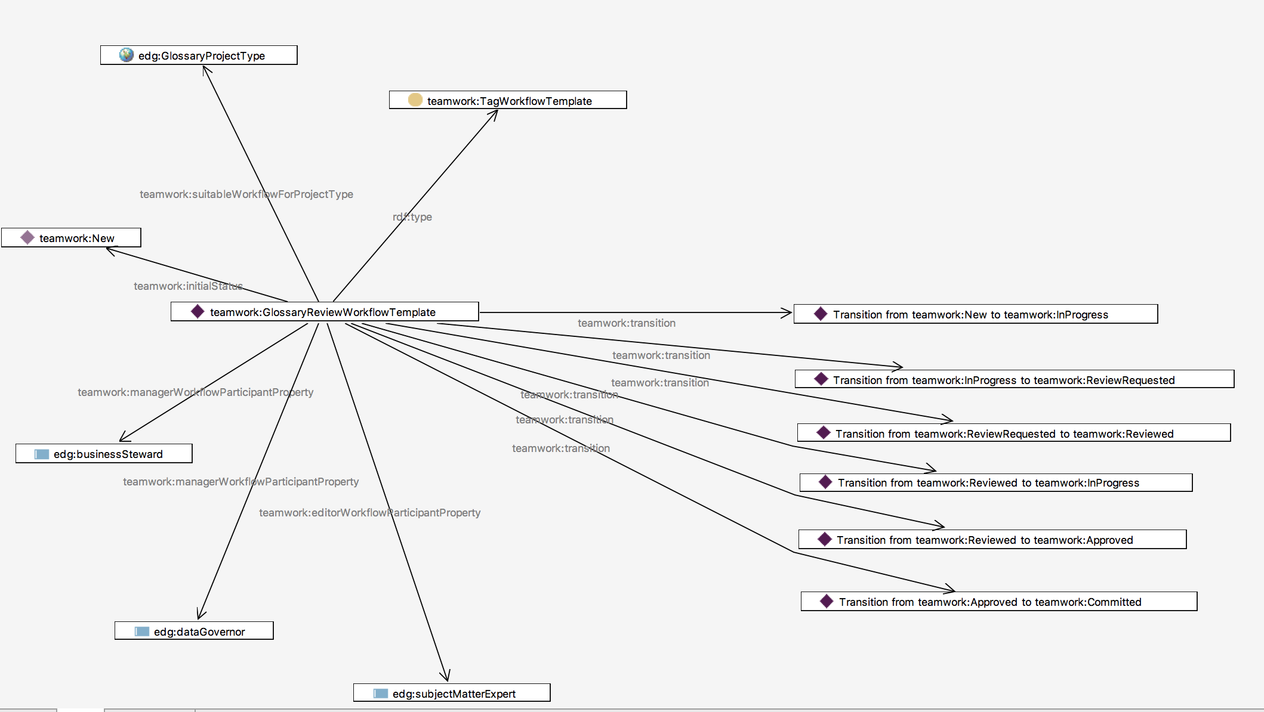
Example Template
This template is only available for glossaries
It is a template to be used for workflows that have working copies
The workflow can be in 6 possible states: New, In Progress, In Review, Reviewed, Approved and Committed.
There are 6 state transitions
Initial state = “New”
If your governance role for a glossary that is being updated through a workflow is Business Steward or Data Governor, you will have Manager permissions for the working copy.
If your governance role is Subject Matter Expert, you will have Editor permissions.
Any other governance role will get the default Viewer permissions

Slide 41
Important Values for a Workflow Transition
Required
teamwork:fromStatus, teamwork:toStatus – from what to what state a transition is progressing the workflow
teamwork:requiredGovernanceRole – defines the governance roles that can perform the transition
Or
teamwork:requiredProjectPermissionRole, teamwork:requiredTagPermissionRole – define necessary production or working copy permissions required to perform a transition
Additional property values depend on the type of transition – timed, voting based, etc.
Use either Governance Roles or
Permissions
Transition type specific

Slide 42
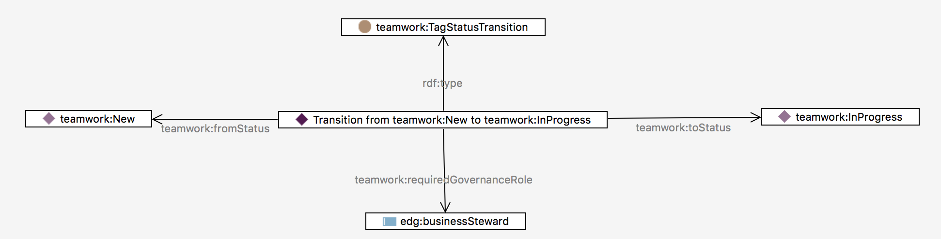
Example Transition
It is a transitions
This transition can happen if the current workflow state = “New”
This transition takes the workflow into “In Progress” state
Only users that have a Business Steward governance role can make this transition happen.
[rdf:type teamwork:TagStatusTransition ;
teamwork:fromStatus teamwork:New ;
teamwork:requiredGovernanceRole edg:businessSteward ;
teamwork:toStatus teamwork:InProgress ;
teamwork:transitionLabel "Start work" ;
ui:height 100 ;
ui:width 160 ;
ui:x 345 ;
ui:y 20 ;]
label to display for the transition
Also available teamwork:actionLabel – used in the EDG UI to as a display name of a step to be taken before a transition can be marked as completed. If absent, the value of teamwork:transitionLabel is used.
Coordinates and size for diagram display, not needed in 6.3 and later

Slide 43
What Happens When a Workflow Transitions from one State to Another
Always, the value of teamwork:status changes
Other actions and changes are possible – as defined in the template
Transition to teamwork:Committed status is special – working copy changes are written to the production copy and workflow is considered completed

Slide 44
Workflow States can carry additional Information
In addition to icons and other annotations, editable status and transition actions can be set for a state.
For example, once a workflow reaches “Approved” state:
  The working copy is not longer editable - no additional changes can be made
  Action defined in the example:WorkflowAction_1 is performed
There are Exit actions as well as Entry actions
FA = Font Awesome
https://fontawesome.com
teamwork:Approved
rdf:type teamwork:TagStatus ;
teamwork:color "#008000" ;
teamwork:editable false ;
teamwork:faIcon "fa-thumbs-up" ;
teamwork:stateEntryAction example:WorkflowAction_1 ;
rdfs:comment "the changes have been approved." ;
rdfs:label "Approved" ;
.
Actions are instances of teamwork:WorkflowAction class and have an associated SWP script with the code (ui:prototype) that executes the action.

Slide 45
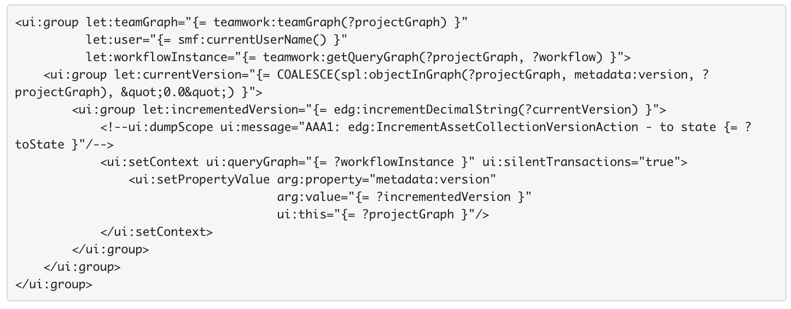
Example SWP code for an Action
Gets the value of metadata:version property of an asset collection
Increments it
Function wraps delete and insert queries as templates that take arguments
Removes the current value of the metadata:version and then sets it to the new incremented value

Slide 46
Notifications in TopBraid EDG

Slide 47
Notification Events in TopBraid EDG - 1
TopBraid EDG has a number of pre-built generic notification events e.g., a new workflow started for an asset collection
  Events are subscribed to by the governance roles. When event occurs, users in subscribed roles will get an e-mail notification
  Default notification setting can be done on the EDG Configuration page under Administrative console
  These are overridden by Notification setting at the collections level (Manage tab)
Notes:
Notifications are defined in teamworknotifications.ui.ttlx
Connection between an asset collection (project) and notification even is specified using teamwork:supportedNotification property

Slide 48
Notification Events in TopBraid EDG - 2
New notification events can be added to address customer requirements
  By sub-classing teamwork:Notifications class e.g., “Dataset Schema Creation” notification
  Asset collection type(s) for which this event is applicable is specified e.g., business glossary or data assets collection
  New event will show up in the Notification page for asset collections of the applicable type – available for subscription by the governance roles
Notes:
Notifications are defined in teamworknotifications.ui.ttlx
Connection between an asset collection (project) and notification even is specified using teamwork:supportedNotification property

Slide 49
ECA Framework in TopBraid EDG

Slide 50
Event Condition Action Framework
ECA Framework supports rules that define actions to execute when certain events happens
  There are special subclasses of rules such as “Edit Rules”, “Commit Rules”, etc. All are subclasses of ui:Rules class.
  To create new actions, define your own subclasses
Notification is one type of a (predefined) action that can be executed when an event happens
Other actions are also possible – predefined and custom
  An action can execute a script which, for example, calls some service

Slide 51
What is Event?
Event is any change in data
For example:
  “Task Created” event happens when a triple such as {?task rdf:type tasks:Task} is added
  Similarly, “Workflow Status Change” event happens when a triple such as {?wf teamwork:status ?status } is added
Event can also be triggered by a deletion of a triple
EDG will watch for these patterns
To support this, EDG has 2 special named graphs available during the execution of a ui:Rule
  ui:addedGraph - containing the triples that were added before the rule was triggered
  ui:addedGraph - containing the triples that were deleted before the rule was triggered.

Slide 52
What is Action?
Anything that you program, requires writing SWP scripts
E-mail notifications are built-in actions
EDG will execute an action specified for an event when it detects that the event happened

Slide 53
How EDG itself uses ECA Framework to perform various actions
EDG perform some housekeeping when certain edits happen. For example:
  If URI construction uses counters, counter is incremented when a new resource is created
  When a value for a symmetric property (e.g., skos:related) is updated, EDG will update the inverse
  If notifications are set, EDG will watch for subscribed events and send e-mails for relevant changes
  In the previous releases when TopBraid EDG was setup to use Solr, it used this approach to update Solr index when a label (or any indexed field) changes

Slide 54
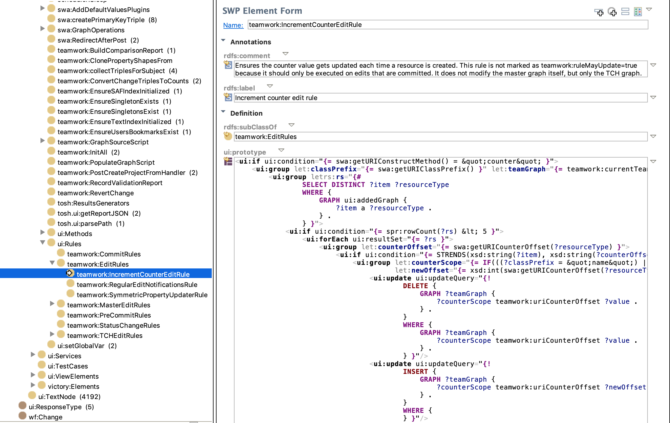
Rule for Incrementing the Counter
To see this code look at the files in the teamworks.topbraid.org project
SWP script is defined as the value of ui:prototype

Slide 55
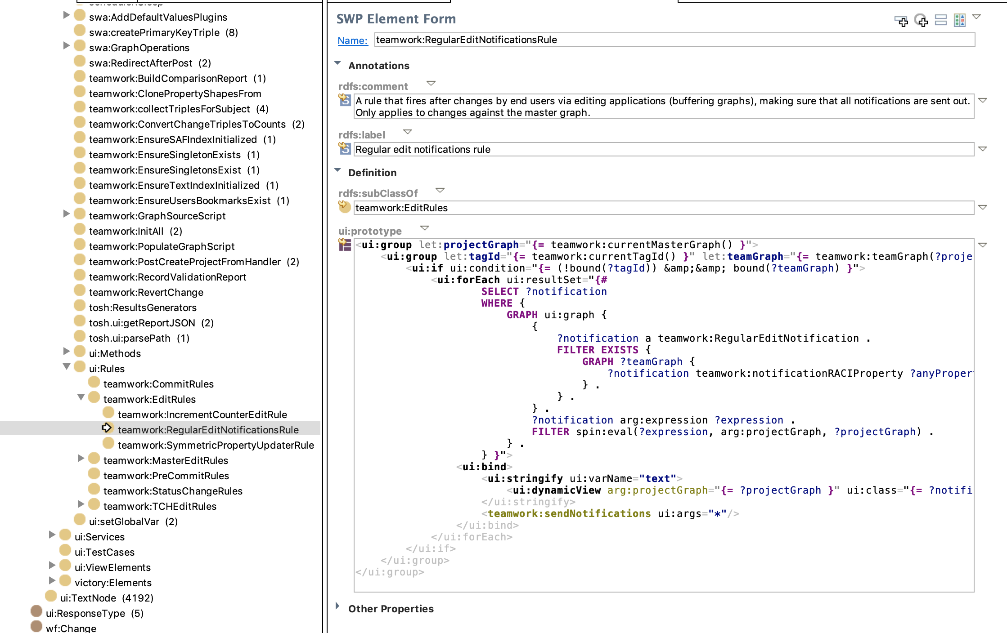
Connection between teamworks:Notifications and teamwork:EditRules is teamwork:RegularEditNotificationsRule
Calls a function that sends e-mails

Slide 56
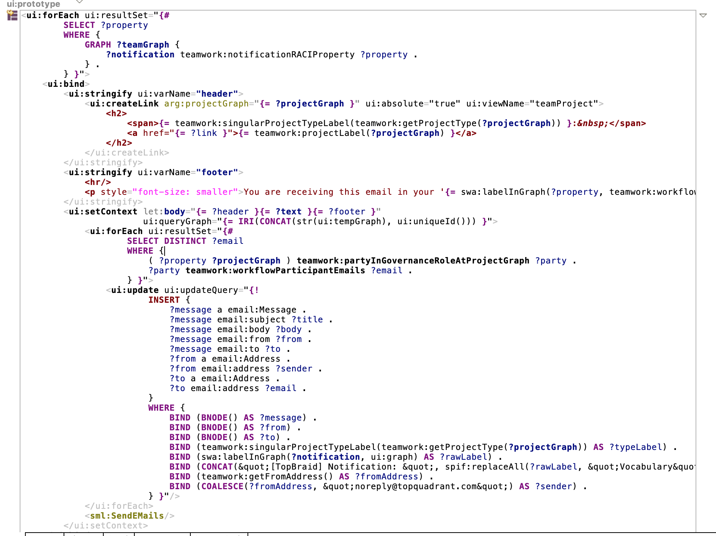
Teamworks:sendNotifications Function that sends e-mails
Body of the e-mail is created
E-mails are constructed
SPARQLMotion Module to send e-mails

Slide 57
Example of a custom action: Display a trace each time a workflow changes state
ExampleTagStatusChangeRule:TestStatusChangeRule
rdf:type teamwork:StatusChangeRule ;
ui:prototype """<ui:group let:newStatus=\”
{# SELECT ?status
WHERE
{ GRAPH ui:addedGraph { ?wf teamwork:status ?status . } . } }\">
<ui:group let:dummy=\"{= smf:trace(&quot;Status changed to {?1}&quot;, ?newStatus) }\"/></ui:group>"""^^ui:Literal ;
rdfs:label "Test status change rule" ;
rdfs:subClassOf teamwork:StatusChangeRules ;
.
Change to watch for - a new status is recorded
Execute when it happens

Slide 58
How to target an action to a specific state change and/or specific workflow
Information about status change can be accessed from ui:addedGraph
  This means that instead of looking for an addition of {?wf teamwork:status ?status}, event can be triggered only when {?wf teamwork:status example:SpecificStatus} is added
The subject of the statement is the working copy/workflow that changed - ?wf variable
teamwork:workflowTemplate on which the ?wf is based can be specified to limit the query to only return the types of workflows for which you want to perform the action for.
  This means that instead of simply looking for an addition of {?wf teamwork:status ?status} triple, EDG will only trigger event when {?wf teamwork:workflowTemplate example:MySpecificType}

Slide 59
Example of updating Solr index
Checks that this is a production copy, not a working copy and that Solr is used for it
<ui:group let:tagId="{= teamwork:currentTagId() }" let:teamGraph="{= teamwork:currentTeamGraph() }">
<ui:if ui:condition="{= ((!bound(?tagId)) &amp;&amp; bound(?teamGraph)) &amp;&amp; teamwork:isSolrProject(?teamGraph) }">
<ui:call ui:template="teamwork:ChangedIndexableSubjects" ui:varName="subjects">
<ui:if ui:condition="{= !spr:isEmpty(?subjects) }">
<ui:call arg:teamGraph="{= ?teamGraph }" ui:template="teamwork:SolrServers">
<ui:forEach ui:resultSet="{= ?rs }">
<sml:ExportToSolrFields sml:selectQuery="{= ?subjects }"
sml:url="{= spl:objectInGraph(?server, solr:url, ?teamGraph) }"
sml:useURIs="true"
sml:userName="{= spl:objectInGraph(?server, solr:userName, ?teamGraph) }"/>
</ui:forEach>
</ui:call>
</ui:if>
</ui:call>
</ui:if>
</ui:group>
Calls a pre-built SPARQLMotion module
that causes Solr index to be updated with the changes
Calls a helper function that will deliver all resources (subjects) that have been changed

Slide 60
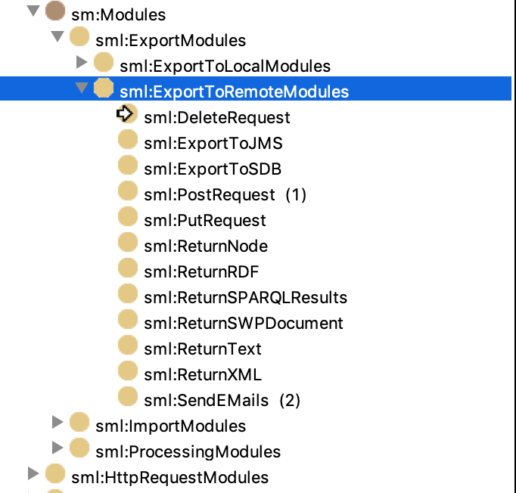
Available “Export to Remote” Modules
New ones can be added

Slide 61
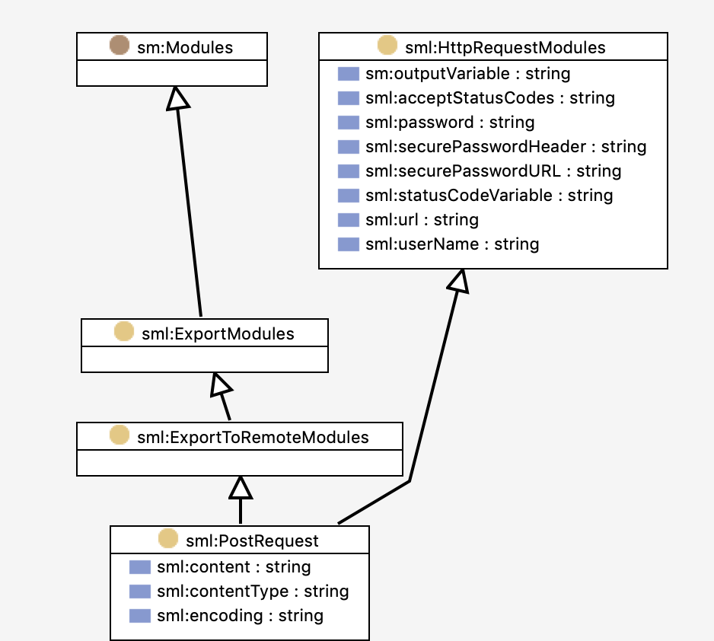
Post Request Module
Sends an HTTP POST request to a web server and binds the body of the response to the outputVariable.
The request will include variable bindings for all non-system properties of this module. For example, you can set arg:test to some value that will be mapped to the name-value-pair \"test\". The recommended way of doing this is to subclass the sml:PostRequest class and declare the additional arguments as spin:constraints.
The variable bindings will be sent in application/x-www-form-urlencoded format. Alternatively, the payload to be sent with the request can be provided directly in the variable sml:content. If a variable starts with "httpHeader_" then the value will be used as HTTP request header with the partial name after the _.
This argument is used to define the name of a variable that will contain a response from a service

Slide 62
How Post Request Module May be Used
Create a Rule. In its prototype use:
<sml:PostRequest
sm:outputVariable="response”
…other arguments such service url (sml:url), user id (sml:user), etc>
<ui:transaction>
... do something with ?response
</sml:PostRequest>

Slide 63
Using ECA Framework versus using State Entry and Exit Actions in Workflows
ECA Framework is a general mechanism for executing actions when any event happens.
  For example, a new task is created or some specific change is made to an asset directly in the production copy
State Entry and Exist Actions are only used in workflows and the only event that can trigger them is a workflow moving to and from a certain state
Performance-wise ECA is more expensive since EDG is constantly monitoring for the change patterns specified in the events

Slide 64
End of the Module

